Slide 1

INTRODUCTION
-Instructors
-Background -Motivation
-Structure -Evaluation
High Impact Skills Development Program
in Artificial Intelligence, Data Science, and Blockchain

Slide 2
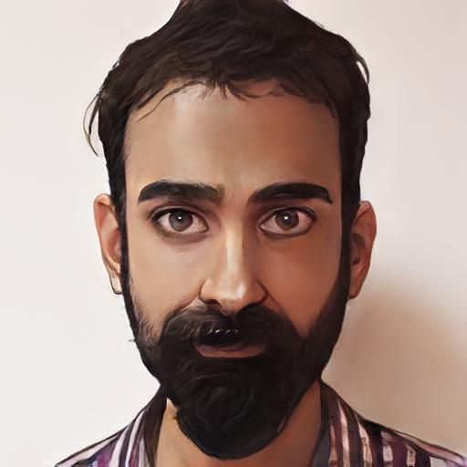
INSTRUCTOR
Assistant Professor
Electrical Engineering,
Room 215, Academic Block, SEECS, NUST, Islamabad
PhD. Network Security
University of New South Wales, Australia
Postdoc
CSIRO, Australia (green computing, software defined networks)
Newcastle University, Australia (cryptocurrencies, blockchain, electronic voting)
MS Course: Cryptocurrencies and the Blockchain
[Details] [Publications] [Articles] [Email: taha.ali@seecs.edu.pk]

Slide 3
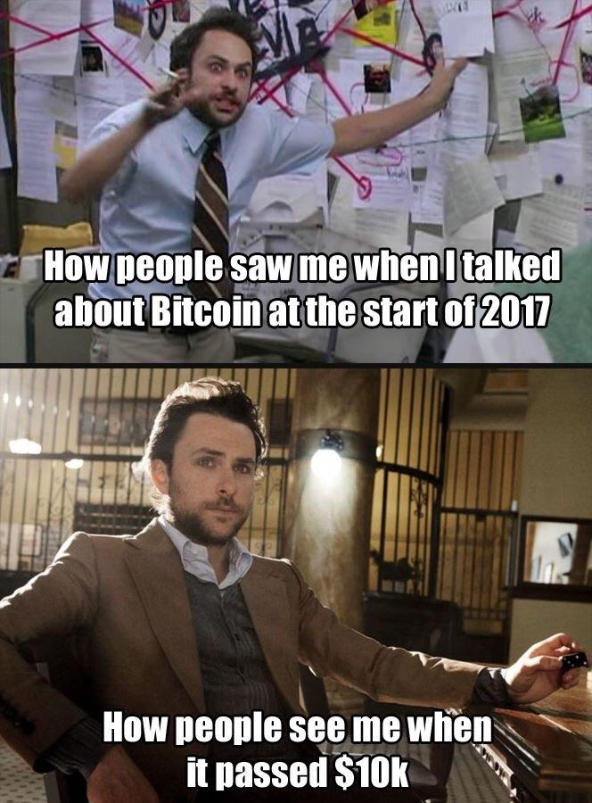
INSTRUCTOR

Slide 4
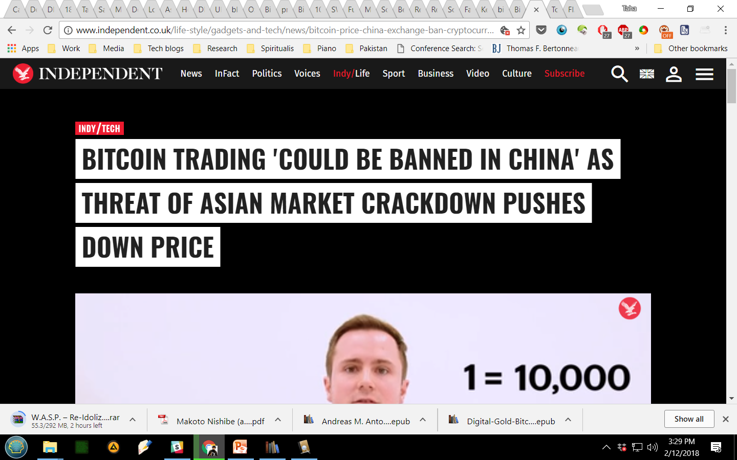
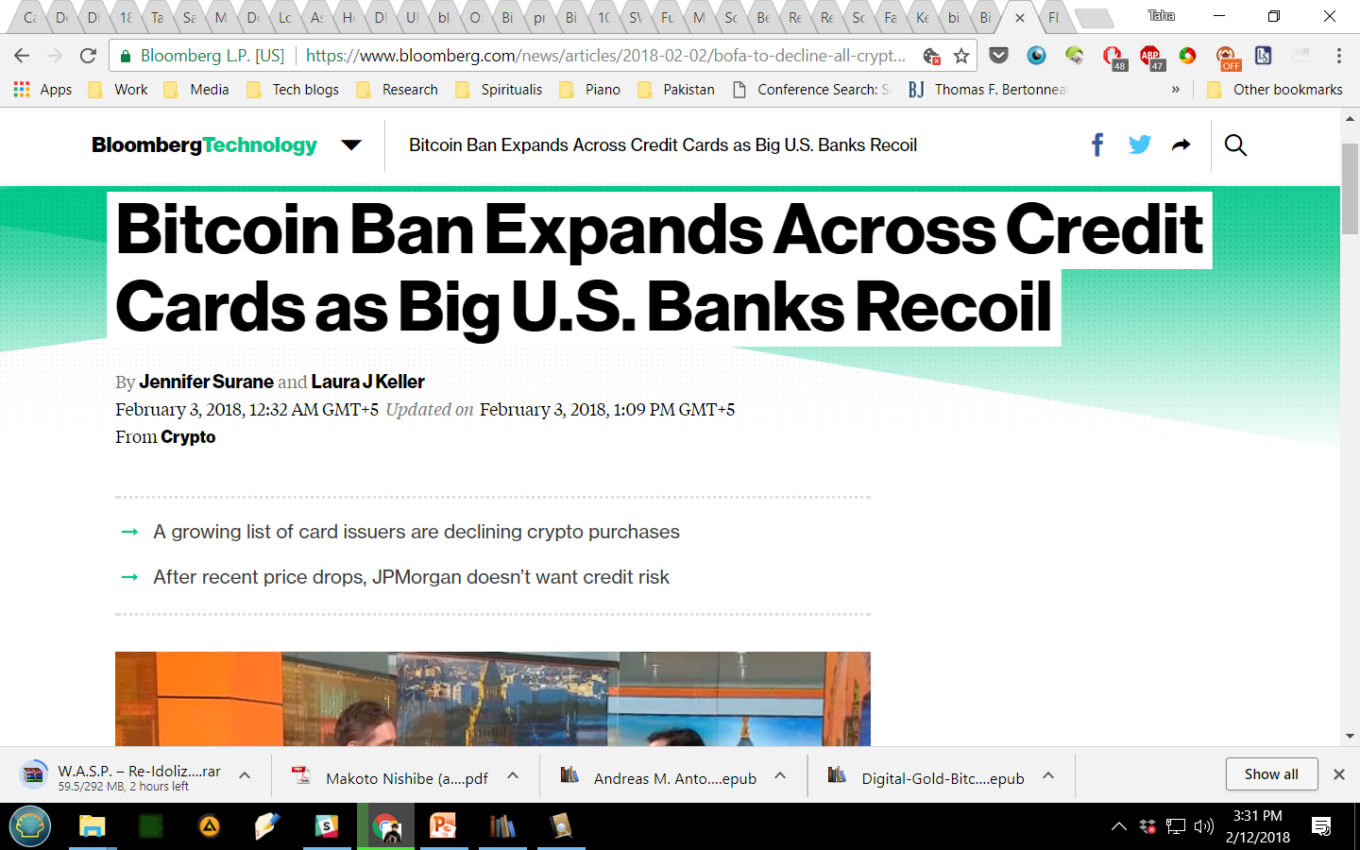
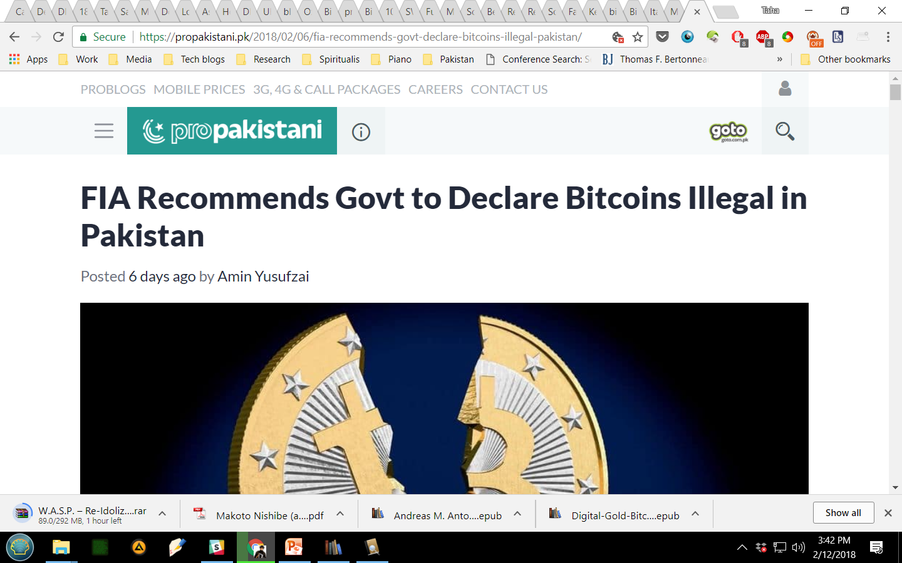
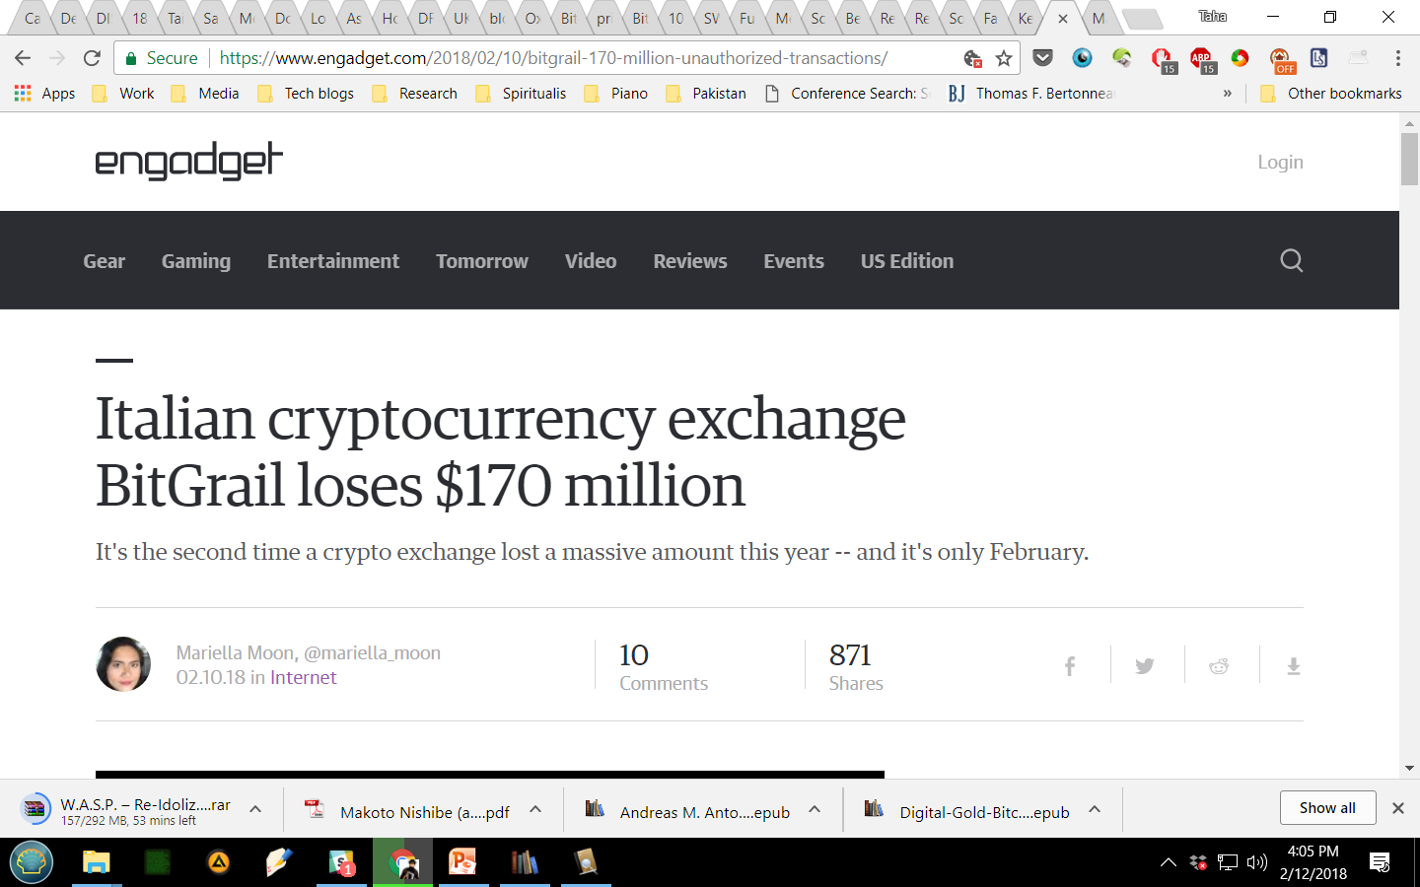
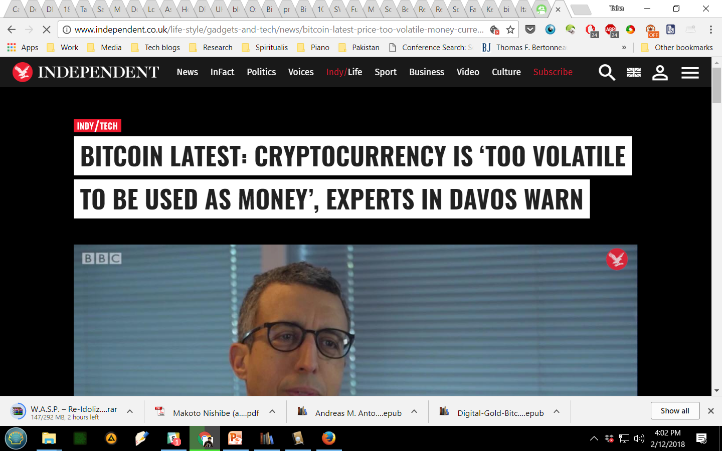
TRENDS: 2018

Slide 5
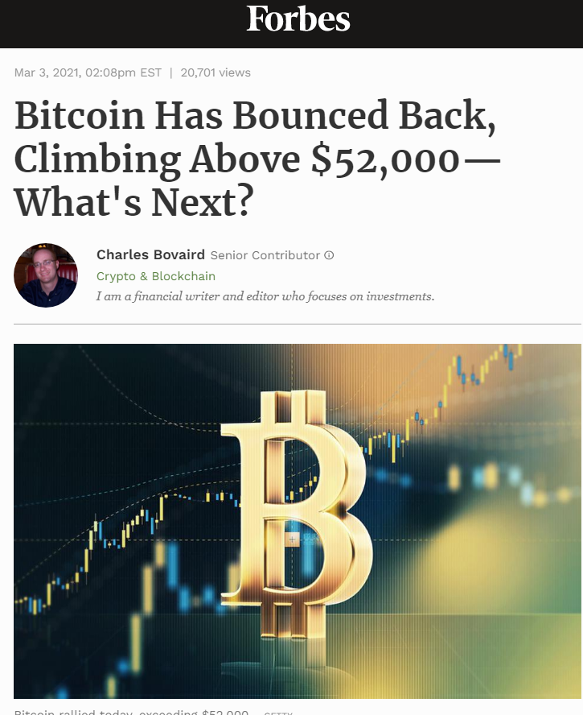
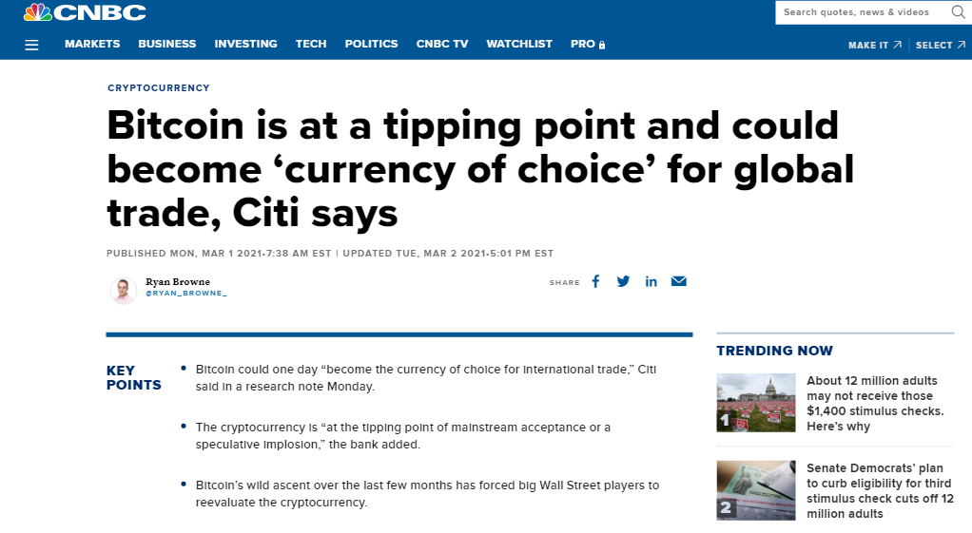
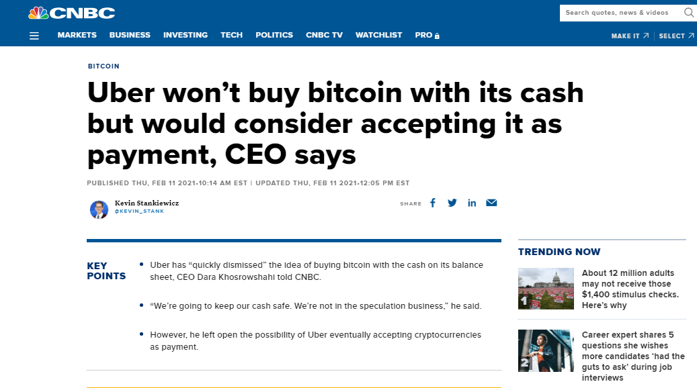
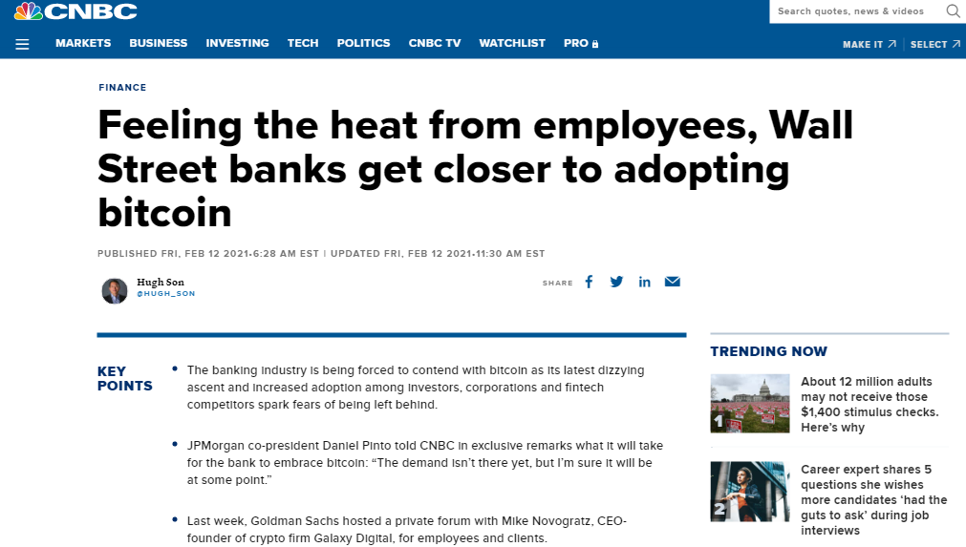
TRENDS: 2021

Slide 6
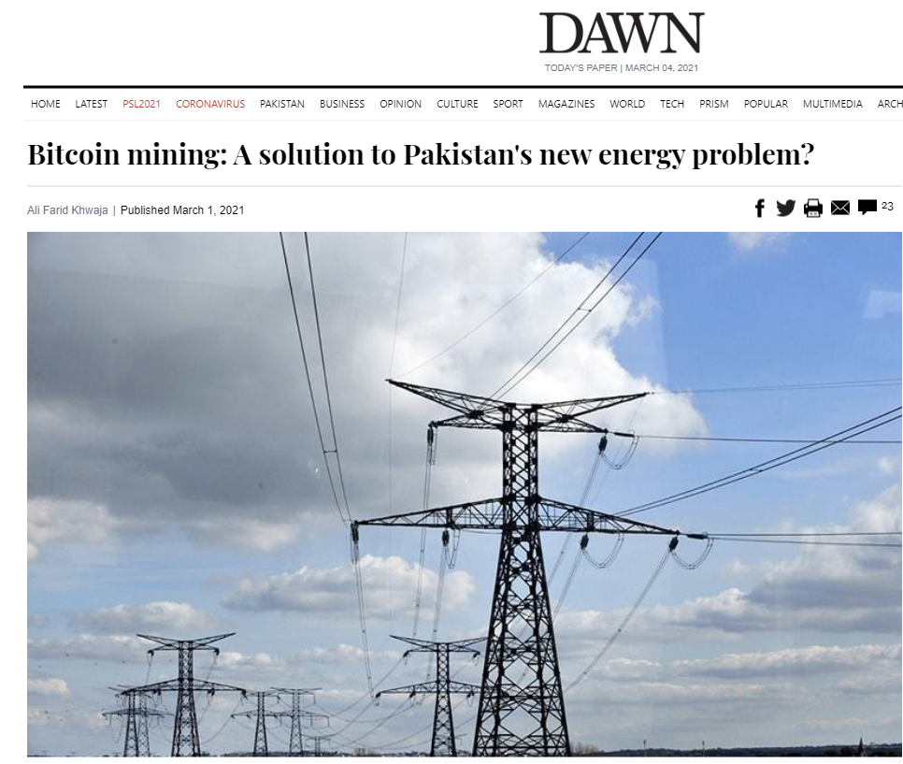
TRENDS: 2021
If Pakistan uses this energy for bitcoin mining using the latest S19 Pro Antminer …it can generate $35 billion worth of Bitcoin per year at current valuations.
….this means we can pay off our external debt in two years.
…Pakistan may already have 50 per cent more capacity than demand.
And even though Pakistan is unable to use the excess it is producing, adding further insult to injury, the government has to pay for the energy even if it is not being used.

Slide 7
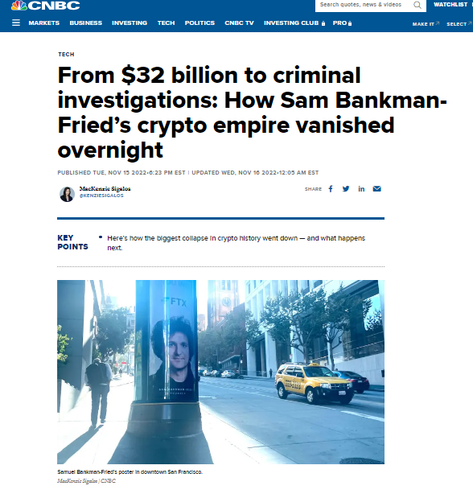
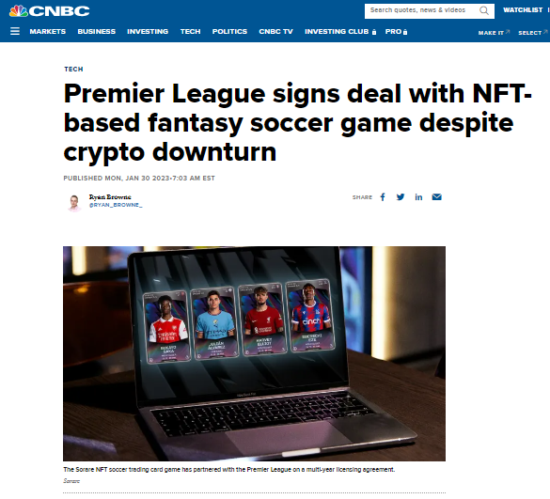
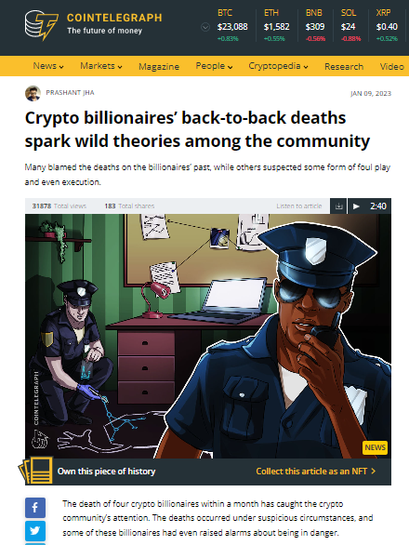
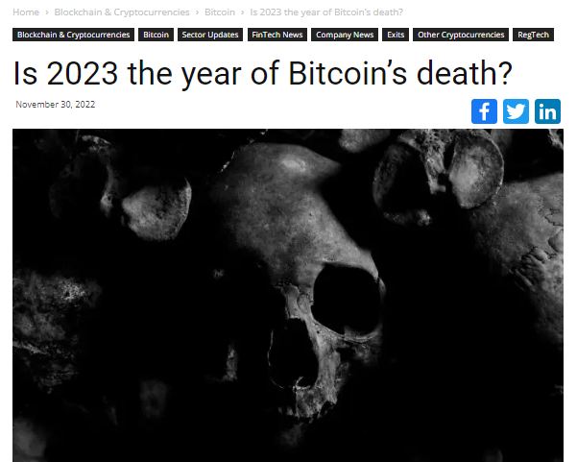
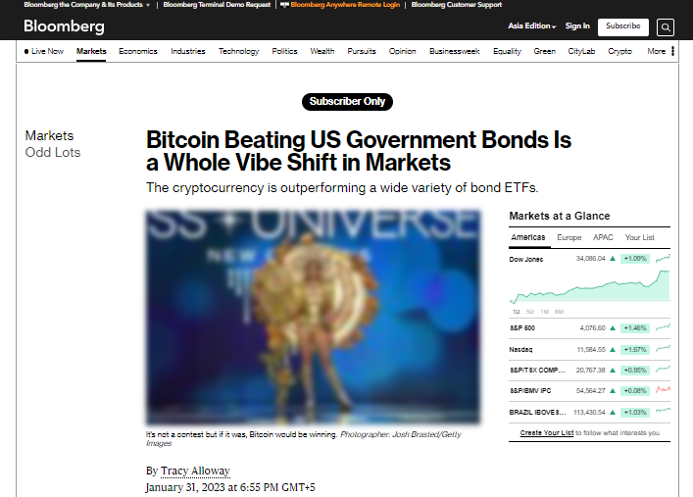
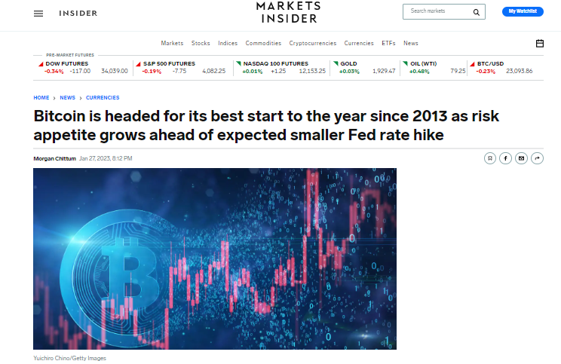
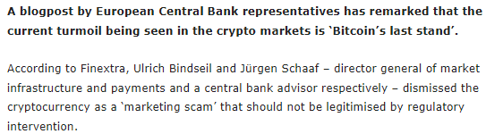
TRENDS: 2022-2023

Slide 8
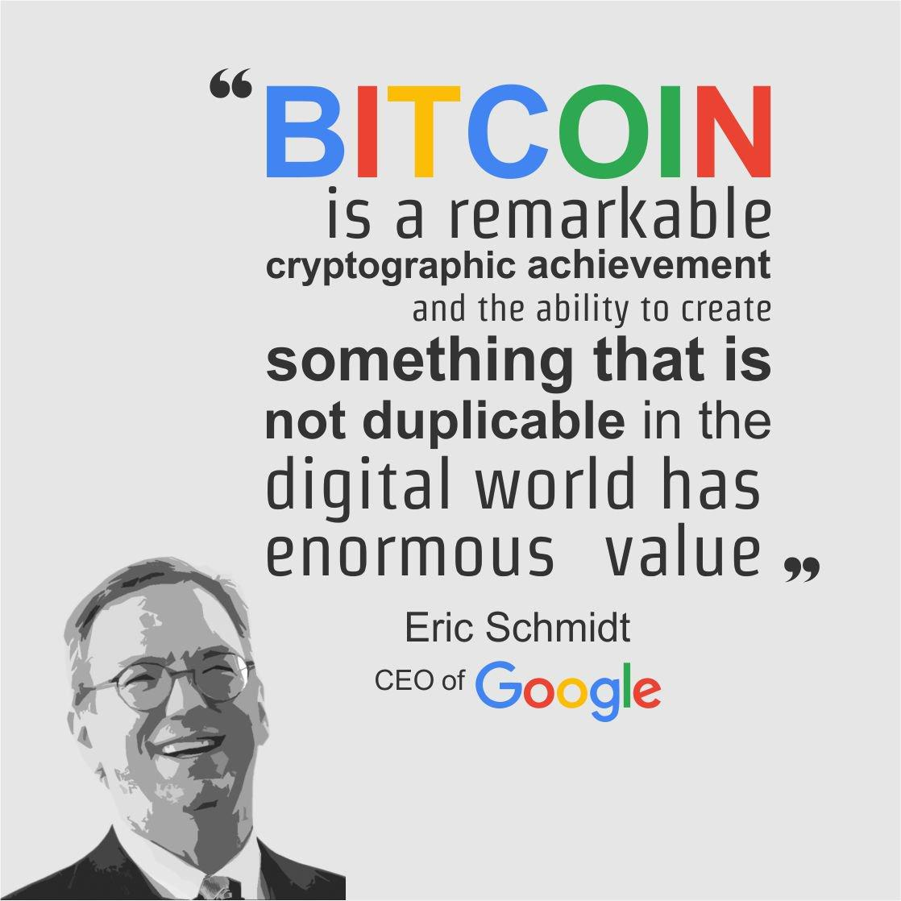
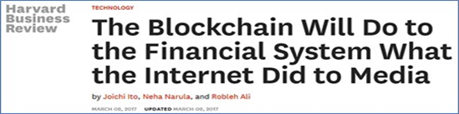
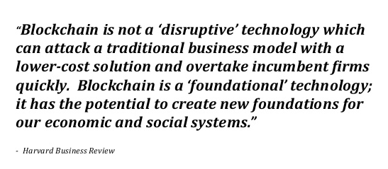
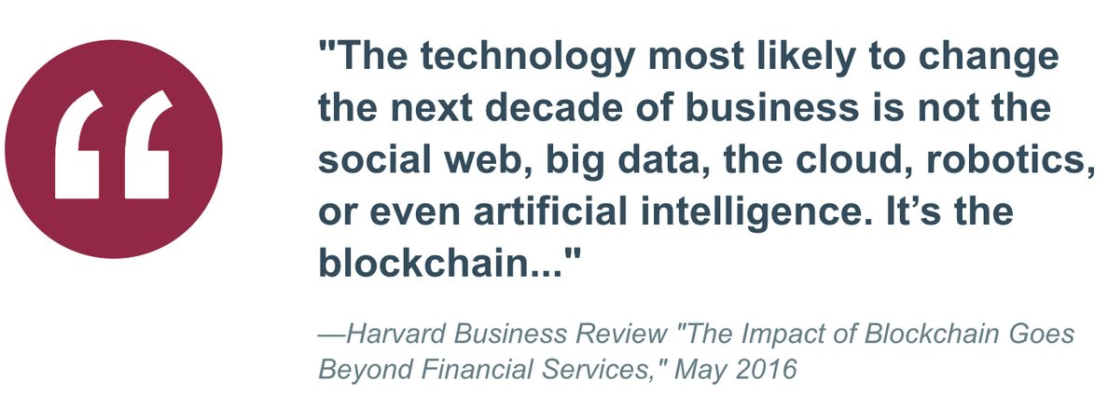
WHY CRYPTO & BLOCKCHAIN?
Notes:
Sources:
1. https://www.nytimes.com/2018/02/08/technology/cryptocurrencies-come-to-campus.html
2. https://hbr.org/2017/03/the-blockchain-will-do-to-banks-and-law-firms-what-the-internet-did-to-media

Slide 9
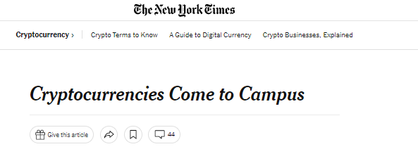
WHY CRYPTO & BLOCKCHAIN?
“This is a very precious opportunity for you to be able to sit in this class,” Dawn Song, a computer science professor, told the students. “There are a bazillion other students who are waiting for your spot.”
“The students in my class are from every possible discipline,” said Campbell Harvey, a professor at Duke’s business school, who is teaching a class with 231 students this semester. “They understand that this is going to disrupt many different areas of business, and they want to be the disrupters, not the disruptees.”

Slide 10
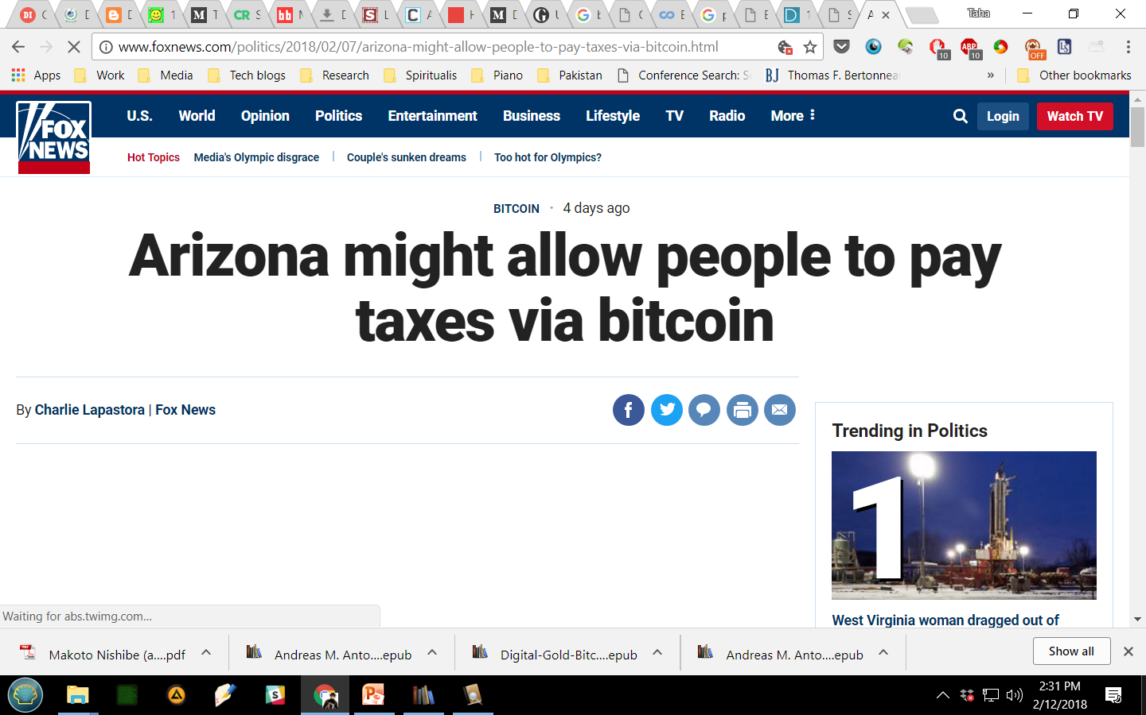
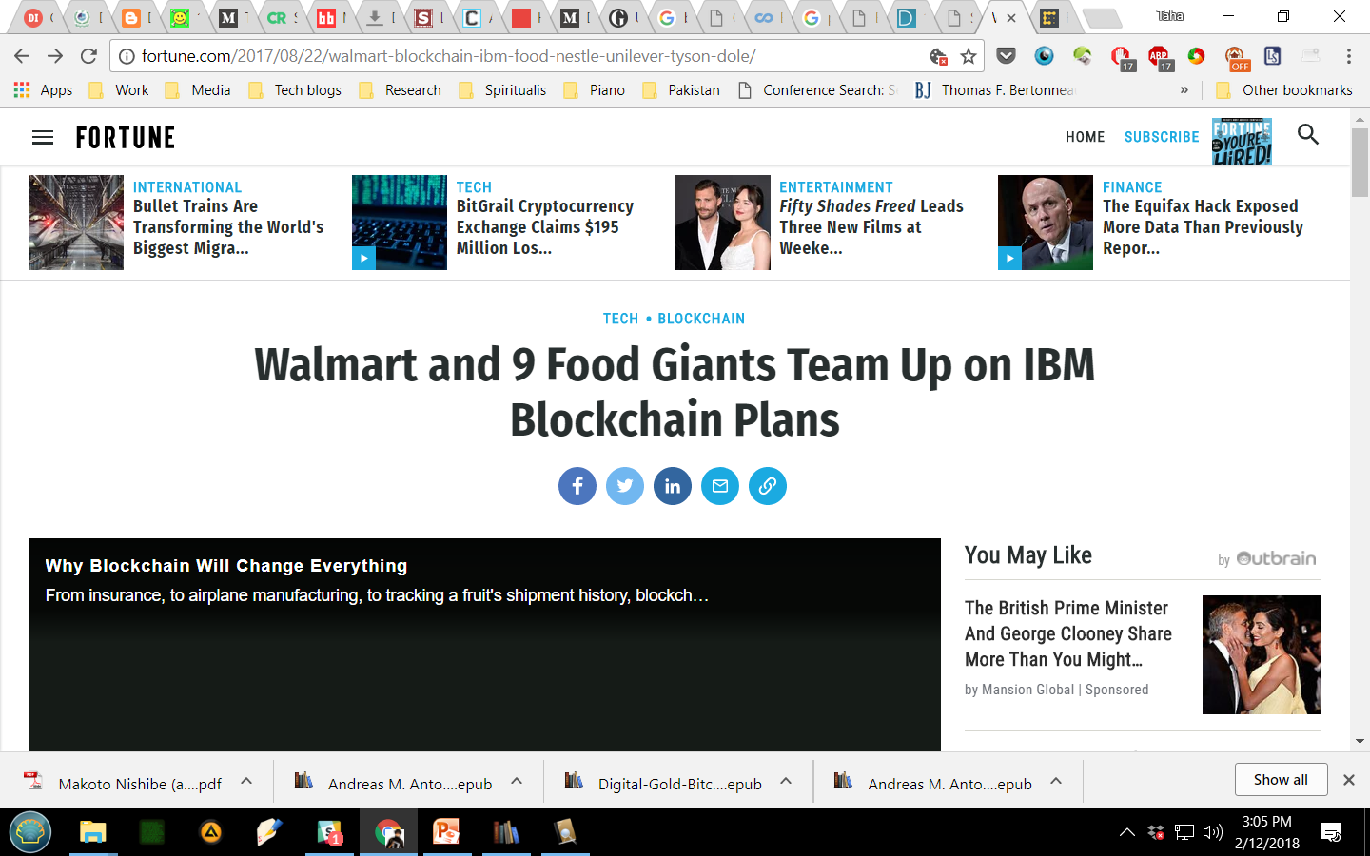
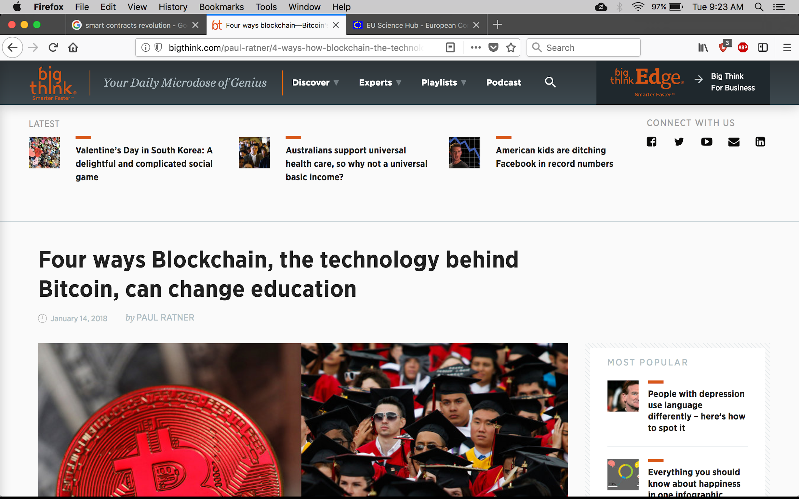
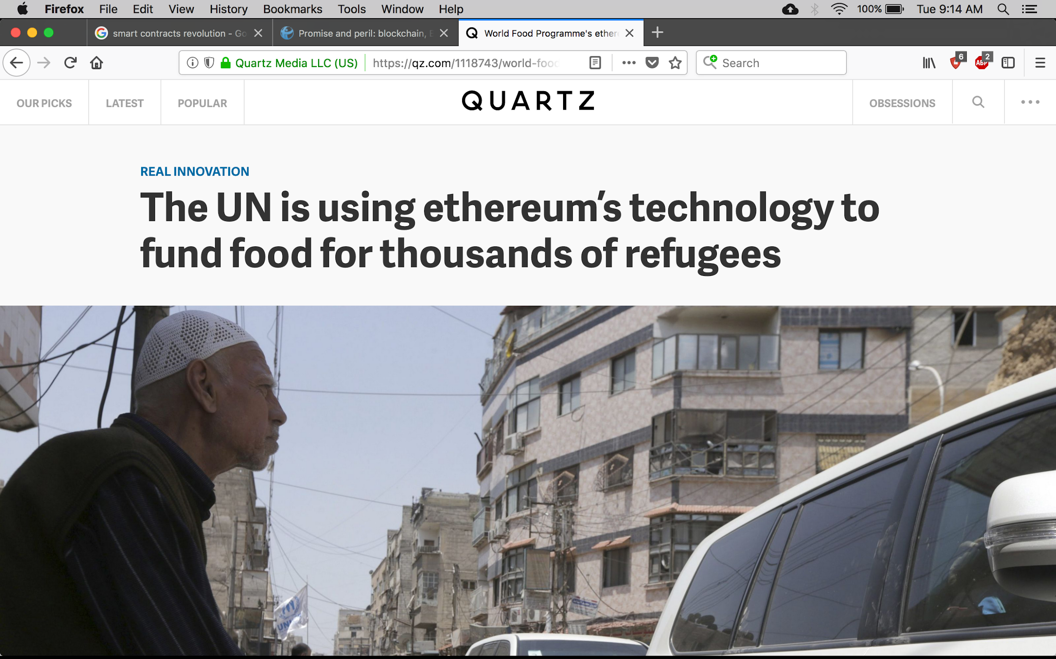
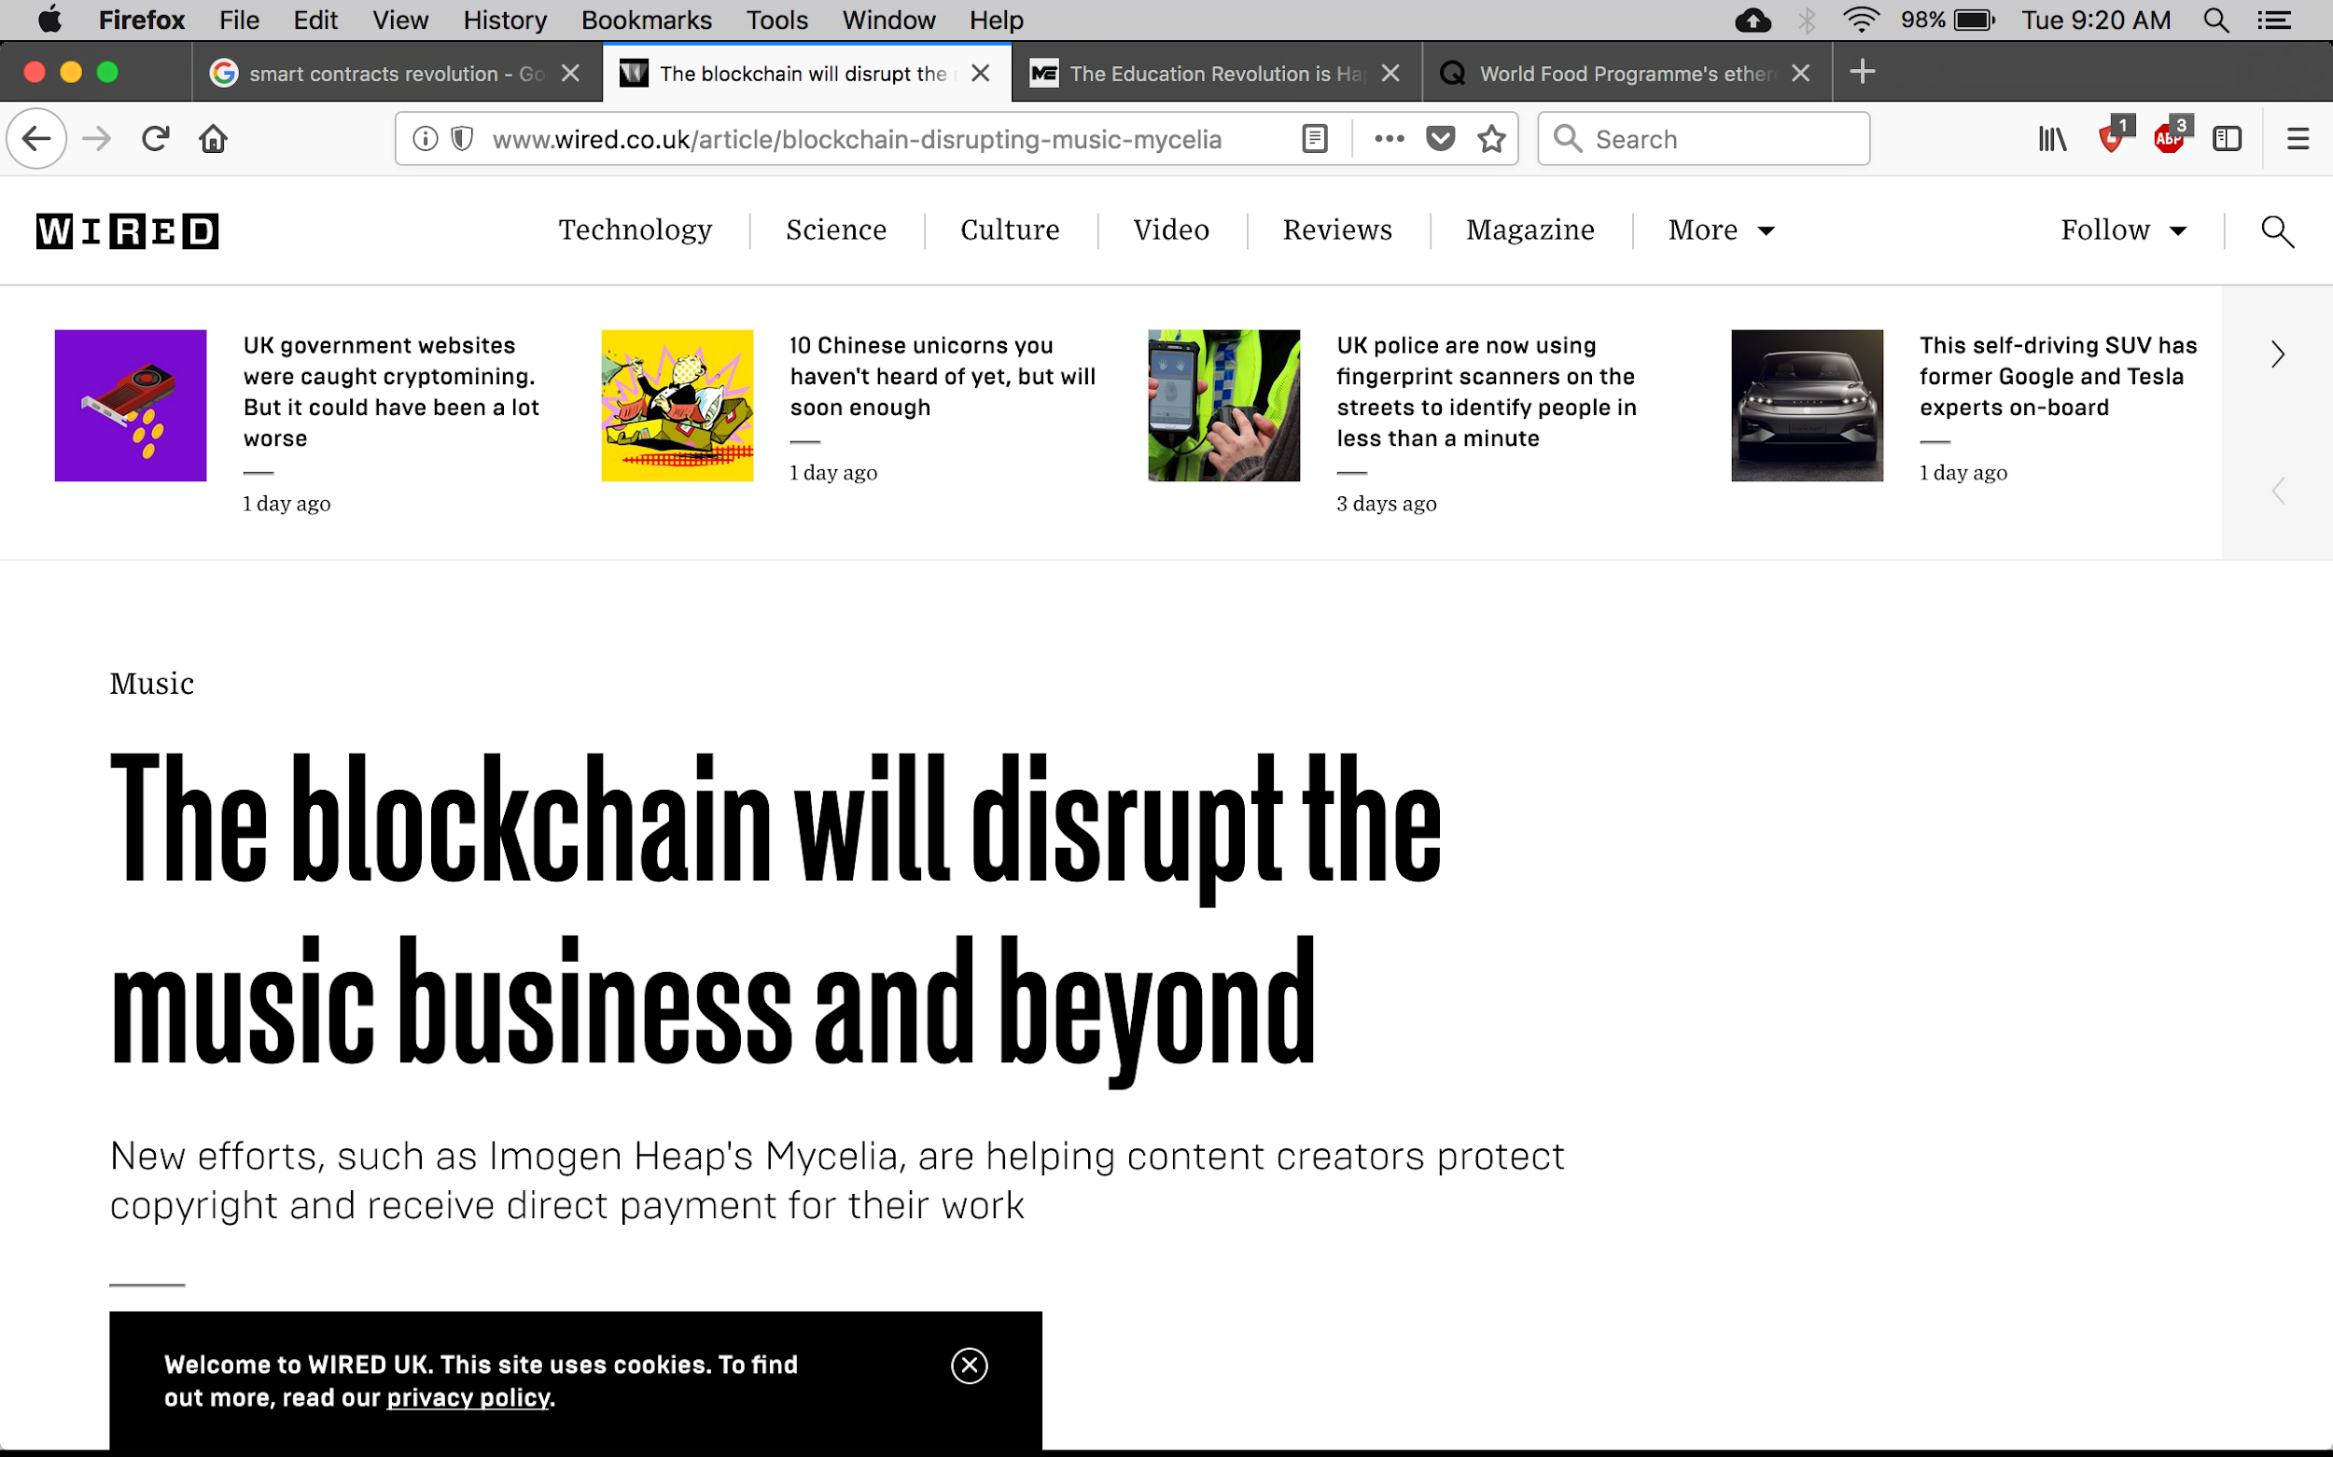
IMPACT
10
Notes:
http://www.foxnews.com/politics/2018/02/07/arizona-might-allow-people-to-pay-taxes-via-bitcoin.html
https://qz.com/1118743/world-food-programmes-ethereum-based-blockchain-for-syrian-refugees-in-jordan/
http://bigthink.com/paul-ratner/4-ways-how-blockchain-the-technology-behind-bitcoin-can-transform-education
https://qz.com/1118743/world-food-programmes-ethereum-based-blockchain-for-syrian-refugees-in-jordan/
https://www.farminguk.com/news/Blockchain-technology-could-revolutionise-farm-to-fork-transparency_48596.html
http://bigthink.com/paul-ratner/4-ways-how-blockchain-the-technology-behind-bitcoin-can-transform-education

Slide 11
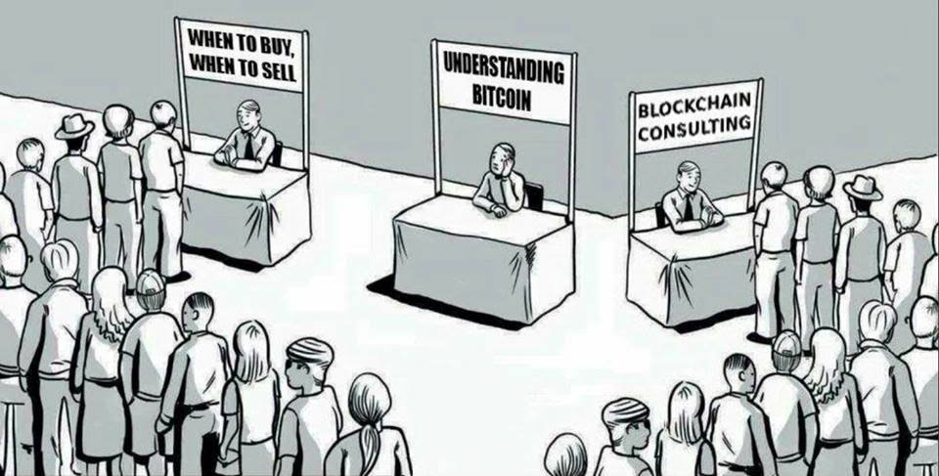
FOCUS

Slide 12
STRUCTURE
0. Introduction
1. Cryptocurrencies and Blockchain
2. Hands-on Ethereum
3. Hands-on Hyperledger
4. Advanced Topics
5. Capstone Project
6. Assessments and Evaluations

Slide 13
MODULE 0
Introduction (Taha Ali – 3 days)
Introduction to the course
Demystifying Bitcoin – nuts and bolts
Bitcoin: economics and worldview

Slide 14
MODULE 1
Cryptocurrencies and Blockchain (Taha Ali + Junaid Younus – 4 weeks)
Building blocks: hash functions, structures, digital signatures, coins
Bitcoin components: consensus, transactions, scripts, networks, blocks
Anonymity: concepts, strategies, innovations
Mining: fundamentals, strategies, evolution
Blockchain: services, smart property, multiparty applications

Slide 15
MODULE 2
Hands-on Ethereum (Haseeb Saeed – 4-5 weeks)
Overview of Ethereum, Solidity, dApps
Smart contracts
Front-end programming
Advanced Solidity
Applications and services: counters, elections, escrow contracts, oracles
Freelancing – strategies and roadmap
Project

Slide 16
MODULE 3
Hands-on Hyperledger (Danyal Ahmad – 4 weeks)
Overview of Hyperledger
Components and configuration
Applications and services: agriculture, food, supply chains
Case studies: Cerberus, BlockCert
Project

Slide 17
MODULE 4
Advanced Topics (Taha Ali – 3-4 weeks)
Tokens
NFTs
Stablecoins
Privacy for blockchains
Decentralized finance
Altcoins
Decentralized storage: IPFS, FileCoin, Storj

Slide 18
MODULE 5-6
Capstone Project (6 weeks)
Assessments and Evaluations (1 week)
Guest talks
Freelancing in the crypto world
Cerberus: blockchain to combat credential fraud
Bitcoin: an Islamic perspective
Bitcoin: Perils of a global P2P cryptocurrency

Slide 19

Happy Learning!

